Slide 1
Sentiment Analysis on Movie Reviews
Advisor: Julian McAuley
Student: WenBin Han

Slide 2
CONTENTS
01
Introduction
02
Method
03
Result
04
Q&A

Slide 3
1
Introduction
01
Purpose
02
Data
03
Challenge

Slide 4





Purpose
Label phrases on a scale of five values.
0 - negative 1 - somewhat negative 2 - neutral 3 - somewhat positive 4 - positive

Slide 5
Data
This 100-minute movie only has about 25 minutes of decent material . 1
This 100-minute movie 2
100-minute movie 2
100-minute 2
only has about 25 minutes of decent material . 1
only 2
has about 25 minutes of decent material . 3
about 25 minutes of decent material 1
about 25 minutes 2
about 25 2

Slide 6
Challenge
sarcasm
Earth is full. Go home.
sentence negation
not, never, no, nothing, etc.
terseness
Brief and to the point.
language ambiguity
Each of us saw her duck.

Slide 7
2
Method
01
Machine Learning
02
Diagram
03
Improvement(if has)

Slide 8
Machine Learning
Training Data
Features
Learn
Model
Predict
Features
Test Data
Label
Result

Slide 9
Machine Learning
Training Data
Features
Learn
Model
Predict
Features
Test Data
Label
Result

Slide 10
Features
Count the number of each word.
Sort by the number.
Grab the top n words as features.
Each sentence has one vector.
The movie only has about 25 minutes of decent material .
[0, 0, 0, 0, 0, … ,0 , 0]
the
about

Slide 11
Machine Learning
Training Data
Features
Learn
Model
Predict
Features
Test Data
Label
Result

Slide 12
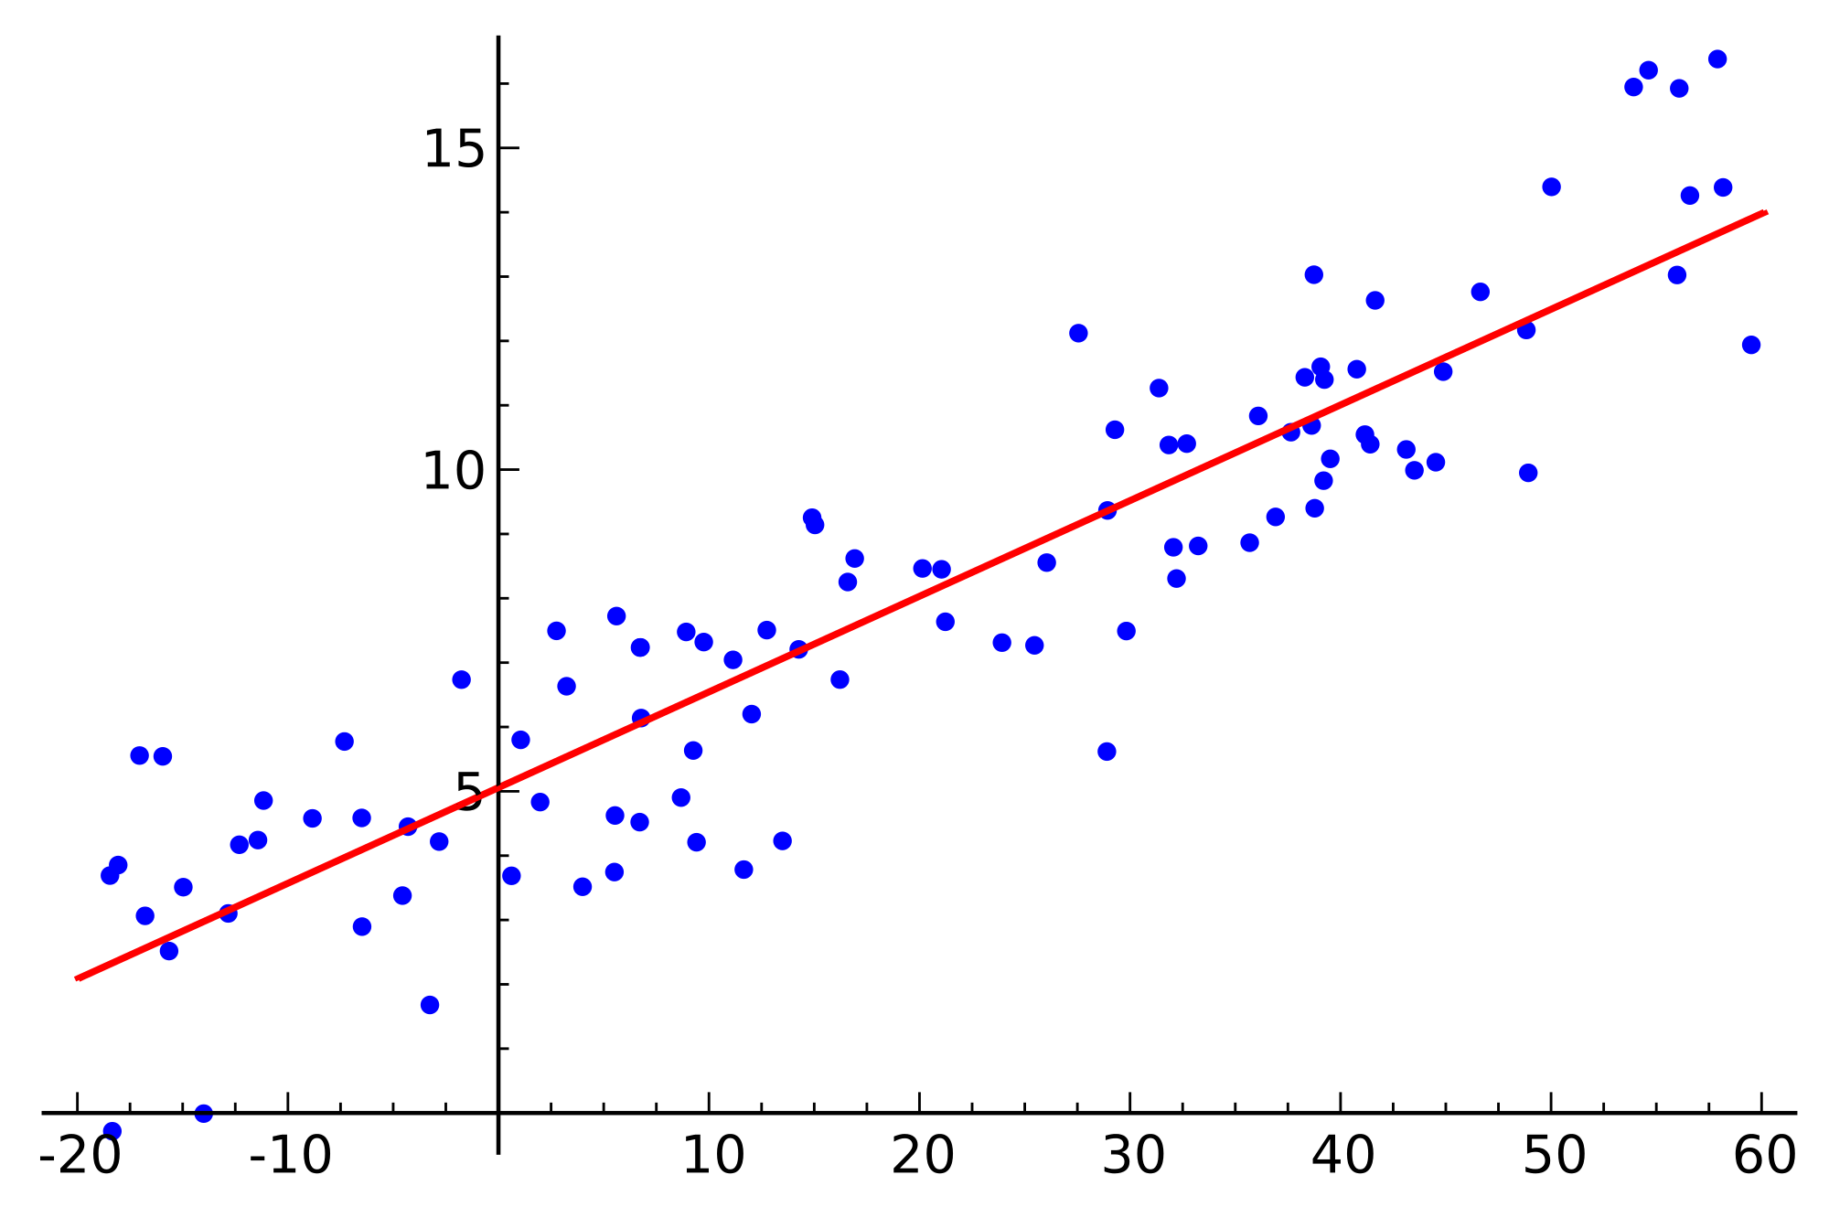

Linear Regression
$$y= θ_{0}+θ_{1}x$$
Notes:
Simple one

Slide 13
Machine Learning
Training Data
Features
Learn
Model
Predict
Features
Test Data
Label
Result

Slide 14
Model
perfection | 1.835453
goodtime | 1.594106
imaginatively | 1.557151
elegance | 1.38889
flawless | 1.376564
hoot | 1.365043
masterful | 1.309927
anatomical | 1.309063
splendor | 1.298317
brilliant | 1.280205
lastplace | -1.52705
insignificance | -1.53023
badmovie | -1.53766
hurts | -1.55874
outbadact | -1.56803
subzero | -1.57245
disappointments | -1.59829
wastes | -1.62432
worthless | -1.67125
disappointment | -1.73917
Notes:
Simple one

Slide 15
Machine Learning
Training Data
Features
Learn
Model
Predict
Features
Test Data
Label
Result

Slide 16
Diagram

Slide 17
Improvement
POS
V
Adv
Adj
Prep
Conj
Interj
N
ProN
Remove punctuation
Do stemming
Filter out stopwords
Use Part-of-Speech
Notes:
In the English language, words can be considered as the smallest elements that have distinctive meanings. Based on their use and functions, words are categorized into several types or parts of speech. This article will offer definitions and examples for the 8 major parts of speech in English grammar: noun, pronoun, verb, adverb, adjective, conjunction, preposition, and interjection.

Slide 18
3
Result

Slide 19
0.76527 The highest score
 | Unigram
Counts | 8000
Remove punctuation | O
Do stemming | O
Filter stopwords | X
Score | 0.59568
0.59568
0.51789 Benchmark

Slide 20
Thank You!

